Slide 1
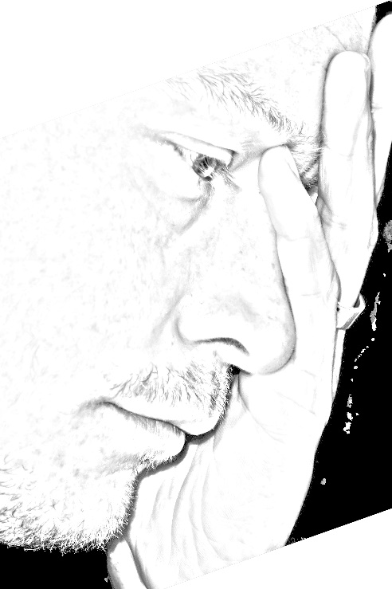
Workplace Harassment
Simon Ferrar

Slide 2
Workplace Harassment
Presentation: Introduction to some terms
Presentation: Why tackle harassment
Activity: What behaviours and attitudes should we address

Slide 3
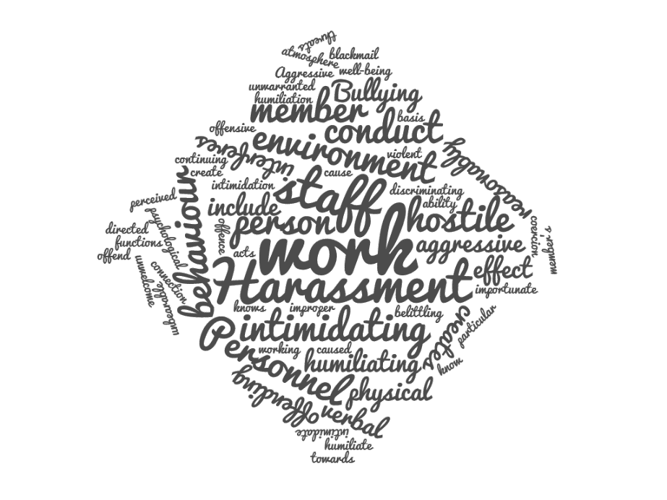
Workplace Harassment
“Harassment is …
any form of treatment or behaviour by an individual or group of individuals in the workplace or in connection with work, which can reasonably be seen as creating a
demeaning,
intimidating,
hostile or
abusive working environment.”
Series of events or single incident
UNIDO DIRECTOR GENERAL’S BULLETIN - Prohibition, prevention and resolution of harassment, including sexual harassment, discrimination and abuse of authority
DGB/2016/13 - 20 December 2016

Slide 4
Workplace Harassment
Harassment … “may take different forms:
(a) Threats, whether verbal or physical;
(b) Aggressive conduct such as yelling or screaming;
(c) Intimidation, coercion or retaliation;
(d) Humiliating, derogatory, offensive or abusive personal comments;
(e) Undermining or isolating conduct that interferes with the ability of an individual
to discharge his or her official duties; and
(f) Malicious and unfounded reports or allegations against an individual.”
UNIDO DIRECTOR GENERAL’S BULLETIN - Prohibition, prevention and resolution of harassment, including sexual harassment, discrimination and abuse of authority
DGB/2016/13 - 20 December 2016

Slide 5
Workplace Harassment
Common elements in defining harassment:
Key aspects:
Includes: violence, abuse, threats attacks – physical or psychological
Not exclusive to workplace – circumstances related to work
Negative impact on a person's safety, well-being, dignity & health
Intent is not the key determinant – it’s the impact – its about unacceptable behaviours
Hostile, degrading, offensive or intimidating work environment
Single or series of behaviours

Slide 6
Workplace Harassment
“Sexual harassment is …
is any conduct or behaviour of a sexual nature in the workplace or in
connection with work, which is unwelcome and offensive and which can reasonably be seen as creating a
demeaning,
intimidating,
hostile or
abusive working environment.”
UNIDO DIRECTOR GENERAL’S BULLETIN - Prohibition, prevention and resolution of harassment, including sexual harassment, discrimination and abuse of authority
DGB/2016/13 - 20 December 2016
Series of events or single incident
Opposite sex or same sex

Slide 7
Workplace Harassment
Sexual harassment includes …
“(a) Unsolicited requests for sexual contact or favours, including as a condition for
employment or advancement;
(b) Unwanted physical contact;
(c) Suggestive compliments;
(d) Remarks, messages or jokes of a sexual nature;
(e) Repeated requests for dates or private meetings, particularly after hours; and
(f) Circulating pornographic images or images displaying nudity.”
UNIDO DIRECTOR GENERAL’S BULLETIN - Prohibition, prevention and resolution of harassment, including sexual harassment, discrimination and abuse of authority
DGB/2016/13 - 20 December 2016

Slide 8
Workplace Harassment
“Discrimination is…
any form of unfavourable, unfair or unequal treatment based on
grounds such as:
ethnicity,
nationality,
Religion (or belief),
Gender (or gender identity),
sexual orientation,
marital status,
disability, or
age.
Perception?
By Association?

Slide 9
Workplace Harassment
"Bullying is aggressive conduct, whether verbal, psychological or physical, in the work environment or in connection with work, of personnel that has the effect of humiliating, belittling, offending, intimidating or discriminating against other personnel or that creates a hostile or offensive work environment.
Aggressive conduct may include intimidation, threats, blackmail or coercion.”
European Bank for Reconstruction and Development
Bullying or Harassment?
Interchangable?
Mobbing?
Bullying behaviour by a group

Slide 10
Workplace Harassment
Gaslighting is a technique of emotional and psychological manipulation. It is where the abuser deliberately attacks the victim psychologically over a period of time in order to make the victim doubt his or her own sense of reality and sanity.
This form of psychological abuse follows a familiar pattern. It can manifest itself in very subtle forms. Essentially, the abuser will consistently deny or refuse to agree with the perceived experiences of the victim, to the point where the victim begins to accept the abuser's version of reality.
Over time the victim eventually gives up on their own point of view, giving the abuser the ultimate power to essentially tell their victim what to think.
Lie & confuse
Isolate – physically, emotionally
Occasional and unexpected positive reinforcement
Project – negatives onto you
You’re the crazy one – not me

Slide 11
Workplace Harassment
Scale of the problem?
Paucity of published data
Staff surveys in several international organisations suggest:
Between 10% - 20% of staff have witnessed or experienced it
Only 2% - 5% of staff report it

Slide 12
Workplace Harassment
Impact of harassment
On individuals:
Anxiety
Depression
Loss of self-esteem
Overt anger
Burnout and emotional exhaustion
Raised blood pressure and other circulatory/cardiac problems
Digestion problems – such as ulcers, changed bowel habits, irritable bowel syndrome
Dietary problems – such as eating disorders, irregular meal times, poor diet
Substance misuse and abuse – alcohol, drug and medication abuse, caffeine etc.
Sleep and sexual problems
Musculoskeletal complaints
Reduced levels of cortisol – impacts on memory, sleep, mood, immune system, energy levels, cognitive functioning, decision making etc.
individuals witnessing harassment can suffer similar health consequences

Slide 13
Workplace Harassment
Impact of harassment
On organisations:
Lower morale,
Lower job satisfaction
Reduced organisational commitment
Negative impact on individual performance outcomes
Lower productivity
Reduced quality of work
Increased errors/mistakes
Poor decision making – reduced efficacy
It has been suggested that the cost to organisations is between $14,000 USD and $18,000 USD per employee.

Slide 14
Workplace Harassment
Activity: What behaviours and attitudes should we address
Aims: This session will help you to:
Consider what unacceptable behaviours should be challenged
Translate definitions in to day-to-day examples
Task: In groups using the definitions of harassment provided and your own experience discuss and agree the attitudes and behaviours that people exhibit that you consider to be harassment.
From the examples identify the attitudes or behaviours that should be addressed through:
Individuals with leadership responsibilities
The organisational systems and processes
Individuals witnessing or experiencing the attitude or behaviour
There will be a plenary discussion about some of the points raised.

